Slide 1
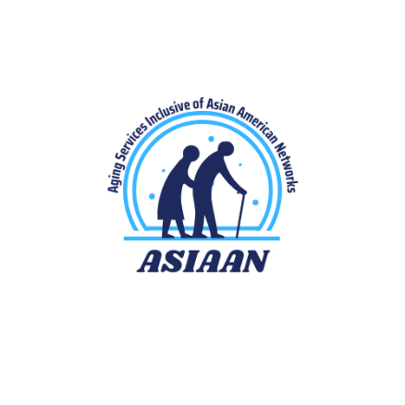
Asian Americans, Aging and Caregiving
Mansha Mirza
Rooshey Hasnain
Jenica Lee
Funding
The creation of this module was supported by the Administration for Community Living (ACL), U.S. Department of Health and Human Services (HHS) as part of a financial assistance award totaling $620,918 with 67% percentage funded by ACL/HHS (Grant number # 90HDRC001 l-01-00, PI: Mirza) and $207,960 or 33% percentage funded by non-government source(s). The contents are those of the author(s) and do not necessarily represent the official views of, nor an endorsement, by ACL/HHS, or the U.S. Government.

Slide 2
Learning Objectives
Describe characteristics of the aging population in the US
Understand how aging services are organized and identify different career opportunities in the field of aging
Recognize that Asian American older adults are at risk of experiencing service disparities
Understand the heterogeneity among different subgroups of Asian American older adults
Summarize cultural perspectives on aging among Asian American communities
Summarize cultural perspectives on caregiving among Asian American communities
Identify common barriers to accessing services for Asian American older adults
2

Slide 3
Aging and Aging Services in the United States
9

Slide 4
Aging trends in the United States
The population of older adults in the United States is growing rapidly!
In 2020, those 65 years and older comprised 16.8% of the US population, a total of 55.8 million people. By 2040, the population is expected to grow to 21.6%.
1920
2020
3

Slide 5
Characteristics of Older Adults in the United States
Gender identification: More women than men (56% vs 44%)
Marital Status: Higher rates of being divorced/separation/spouse absent; 15% in 2020 compared with 5% in 1980
Living Arrangement: Most want to ‘age in place’; proportion of those living in institutions increases with age (1% in the 65-74 age group; 8% for those over 85)
Racial/Ethnic Diversity: In 2019, 24% of persons aged 65 and older were members of racial or ethnic minority populations
4

Slide 6
Aging Services Network
General Aging Service Providers
Governmental
Ethnic CBOs
Healthcare
Administration for Community Living
Area Agencies on Aging
Mutual Aid Associations
Hospitals
State Departments on Aging
Refugee and Immigrant Serving Agencies
Adult Day Centers
Geriatric Clinics
Senior services through the city government
Senior support programs through faith-based organizations
Ethnic social service agencies
Assisted living and Long-term Care Institutions
Senior recreation activities through park districts
Hospice
22

Slide 7
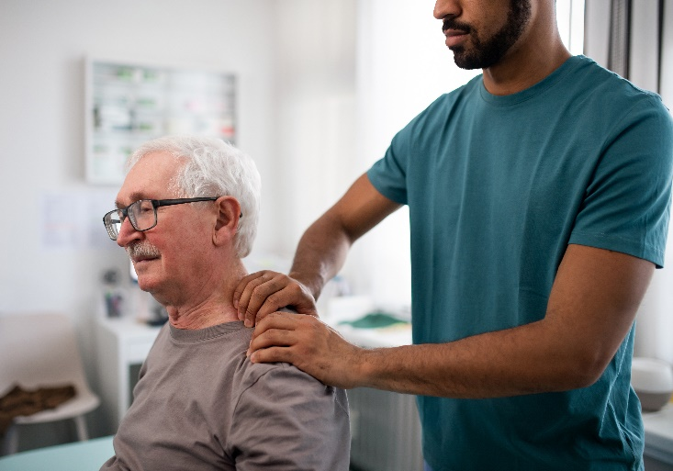
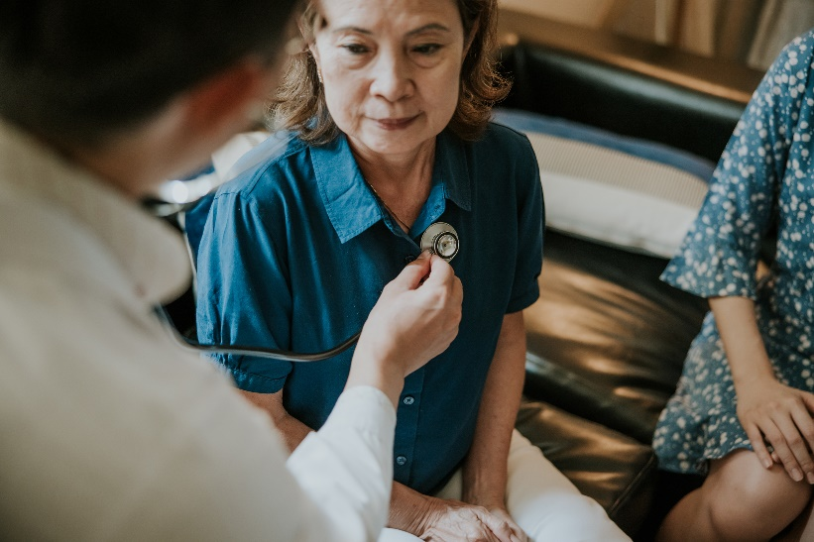
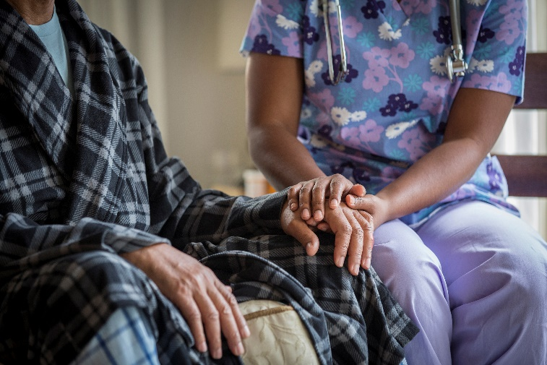
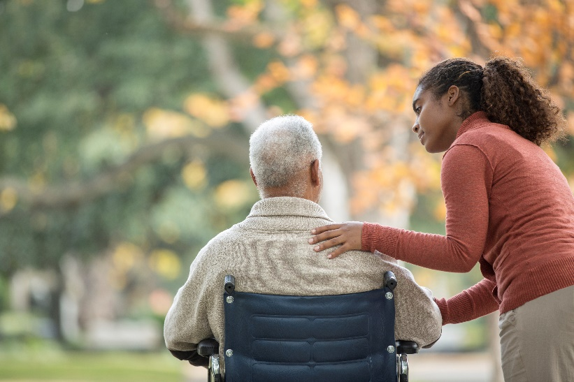
Career Opportunities in the Field of Aging

Slide 8
Take a thought break.
Write down what career opportunities in the field of aging seem of interest to you
9

Slide 9
Aging Asian Americans
9

Slide 10
Who are Asian Americans?
People who fall under the category of ‘Asian American’ trace their ancestry to many different countries of origin in Asia.
In 1968, the term ‘Asian American’ was used for the first time to signify a political alliance of Americans across different Asian ethnic groups.
The creation of this political alliance was inspired by the Black Power movement and in reaction to a long history of discrimination against people of Asian origin in the US.
From here on, the umbrella term ‘Asian American’ caught on and was adopted by the federal government, the media, academia, and other entities.
The term was also considered a respectful alternative to less respectful terms such as ‘Orientals’.
While politically useful and respectful, some people worry that the category of Asian Americans is very broad and can erase the distinct cultural realities of many different subgroups.

Slide 11
There is a lot of heterogeneity among Asian Americans!
The 2020 Census included more than 40 detailed subgroups under this umbrella category!
85% of the 24 million Asian Americans identify with six origin groups: Chinese, Asian Indian, Filipino, Vietnamese, Korean, and Japanese
https://www.census.gov/newsroom/facts-for-features/2023/asian-american-pacific-islander.html

Slide 12
A closer look at Asian American older adults
In 2020, Asian Americans accounted for 5% of older adults in the US
The population of Asian American older adults is expected to quadruple from 2.2 million in 2017 to 7.8 million in 2060 i.e. from <3% to 9% of the US population of older adults
5

Slide 13
Older Asian Americans are, therefore, a diverse group
Hmong, Burmese and Nepalese Americans are relatively young while Thai and Japanese Americans are the oldest.
27% of Asian American older adults live in multigenerational households – more likely for Bhutanese, Cambodians, and Laotians
English proficiency varies widely; according to a 2013 report:
Sixty percent of Asian Americans and Pacific Islanders 65 years or older had limited proficiency
85% spoke a language other than English at home.
31% were believed to be linguistically isolated
English proficiency rates are highest among Japanese, Filipinos, and Indians and lowest among Bhutanese and Burmese

Slide 14
Time for
Self-Reflection
8

Slide 15
Age & Gender
Popular culture and Media
Family context
Perspectives on Aging
Opportunity for multi-generational contact
Religious
background
Population Demographics
Cultural background
12

Slide 16
Asian American Perspectives on Aging and Caregiving
13

Slide 17
Perspectives on Physical Health and Fitness
Karmic Causes (South Asian Indian)
Fatalism (South Asian)
Bahala na (in God's hands (Filipino)
Acupuncture (East Asian)
Cupping (East & Southeast Asian)
Homeopathy (South Asian)
Ayurveda (South Asian Indian)
Culturally Embedded Explanatory Schema
Trust in Alternative Therapies
Physical Debility seen as a Normal Part of Aging
Mind-Body Holism
Balance and Harmony
Across sub-cultures
More accepting of feeling old and becoming less fit
Less emphasis on preserving youth
Yoga (South Asian)
Tai Chi (East Asian)
14

Slide 18
Taboo Topic
Stigma
Sign of Weakness
Perspectives on Mental Health
(Kim, 2020)
Shame
Saving Face
Need to keep it private, within the family
15

Slide 19
Mental health of Asian American Older Adults
Lower prevalence of diagnosed mental health conditions (e.g. mood disorder, anxiety disorder) compared with other racial/ethnic groups (Kim et al., 2011, 2012)
Challenges with applying diagnoses due to unique presentation
Present with somatic symptoms more than emotional distress (Lin & Cheung, 1999)
Avoidance of terms such as ‘mental illness’ and ‘depression’
Greater acceptances of terms such as ‘stress’, ‘thinking too much’, ‘reminiscing about the past’
Variation in prevalence of mental health issues between different groups of Asian American older adults (Kim, 2020)
Attributed to differences in immigrant history, exposure to war experience, English proficiency, or socioeconomic status
Underutilization of mental health services for Asian American older adults (Sorkin et al., 2011) and for Asian Americans in general (Yang et al., 2020)
16

Slide 20
History of Immigration Plays a Role
Asian American older adults with more recent immigrant history are at higher risk of generalized anxiety, depression, loneliness and isolation (Casado & Leung, 2002; Jimenez et al., 2010; Tummala-Narra et al.,2013)
Contributing factors:
Difficulty establishing new connections due to limited language and cultural proficiency
Loss of pre-migration networks
Limited financial resources
Higher dependence on children
Tenuous inter-generational dynamics
More life stresses
17

Slide 21
Strong sense of obligation and anticipation of caregiving role (Chinese)
'utang na loob', a debt of gratitude from children to parents (Filipino)
Expectation of being cared for by eldest son and wife (South Asian)
Caregiving Perspectives
Collectivism
Filial Peity
Family Hierarchy
Reciprocity i.e. you receive care in the future due to present care for the elderly (Japanese)
Family and community play an important role in caregiving; family cohesion is important (Korean)
If children care for parents, both parents and children will reincarnate at a higher level in the future (Vietnamese)
18

Slide 22
Prefer family care
Fear being alone
Fear becoming a burden
Other life demands limit caregiving capacity
Worry about 'losing face' by using formal services
Risk of strain and stress
Generational differences in expectations
Cultural transition
Careful process of negotiation among family members
-Resources available
-Family hierarchy
-Endorsement by family members
Different levels of acculturation
Disconnects between cultural and structural context
19

Slide 23
Time for More Self-Reflection
Revisit your journal notes
Have your perceptions related to aging changed?
20

Slide 24
Service Barriers Experienced by Asian American Older Adults
Lack of culturally relevant services
Lack of language supports within service systems
Inadequate community outreach
Social isolation
21

Slide 25
Brainstorming Solutions to Service Barriers
Training service providers to understand the unique needs and challenges of Asian American older adults
Drawing bilingual and bicultural service providers into aging service networks
Modifying services to be linguistically accessible and culturally relevant for Asian American older adults
Accessible and meaningful community outreach.
Translating brochures and handouts into multiple Asian languages.
Advertising services through ethnic media such as ethnic radio shows, newspapers published in primary languages.
Social media applications such as WeChat, WhatsApp, KakaoTalk
Training community health workers to serve as cultural brokers or liaisons
Notes:
Let’s brainstorm some solutions to these service barriers.
We need service providers who understand the unique needs and challenges of Asian American older adults. Trainings such as this one are critical as some of you might be joining the cadre of aging service providers in the future. It is also important to draw more bilingual and bicultural service providers into aging service networks.
We need services to be linguistically accessible and culturally relevant for Asian American older adults.
We also need more accessible and meaningful community outreach. Some examples include translating brochures and handouts that describe services and eligibility criteria into multiple Asian languages. Advertising services through ethnic media such as ethnic radio shows, newspapers published in primary languages and commonly used social media applications such as WeChat, WhatsApp, KakaoTalk.
Another strategy might be to train community health workers to serve as cultural brokers or liaisons
i.e. someone who can be in charge of bridging, linking or mediating between Asian American older adults and aging service systems.
Can you think of others?

Slide 26
Wrap up discussion
1. In the next 5 years, do you see yourself in the role of an aging service provider?
2. Where in the aging services network do you see yourself?
.
23
Notes:
It’s time to wrap up. We have a couple of questions for you to consider before you end this module.
1. In the next 5 years, do you see yourself in the role of an aging service provider?
2. Where in the aging services network do you see yourself?
You do not have to answer these questions right now. Take your time and ponder over them and think about how the information you learned in this module can inform your future career choices.

Slide 27
Thank you
Mansha Mirza
mmirza2@uic.edu
24
Notes:
Thank you for reviewing this module. We hope you found it helpful.

Slide 28
Sources
Administration for Community Living (2021). 2020 Profile of Older Americans. https://acl.gov/sites/default/files/aging%20and%20Disability%20In%20America/2020Profileolderamericans.final_.pdf
Budiman, A., & Ruiz, N.G. (2021). Key facts about Asian origin groups in the U.S. PEW Research Center. https://www.pewresearch.org/short-reads/2021/04/29/key-facts-about-asian-origin-groups-in-the-u-s/
Casado, B. L., & Leung, P. (2002). Migratory grief and depression among elderly Chinese American immigrants. Journal of Gerontological Social Work, 36(1–2), 5–26. https://doi.org/10.1300/J083v36n01_02
Clan, Z. (2023). U.S. Older Population Grew From 2010 to 2020 at Fastest Rate Since 1880 to 1890. Census.gov. https://www.census.gov/library/stories/2023/05/2020-census-united-states-older-population-grew.html
Jimenez, D. E., Alegría, M., Chen, C. N., Chan, D., & Laderman, M. (2010). Prevalence of psychiatric illnesses in older ethnic minority adults. Journal of the American Geriatrics Society, 58(2), 256–264. https:// doi:10.1111/j.1532-5415.2009.02685.x
Kaur, H. (2022). The term ‘Asian American’ has a radical history. https://www.cnn.com/2022/05/04/us/history-of-term-asian-american-cec/index.html
Kim, G., DeCoster, J., Chiriboga, D. A., Jang, Y., Allen, R. S., & Parmelee, P. (2011). Associations between self-rated mental health and psychiatric disorders among older adults: Do racial/ethnic differences exist? The American Journal of Geriatric Psychiatry, 19(5), 416–422. https://psycnet.apa.org/record/2011-08866-003
Kim, G., Bryant, A. N., & Parmelee, P. (2012). Racial/ethnic differences in serious psychological distress among older adults in California. International Journal of Geriatric Psychiatry, 27(10), 1070–1077. https://doi:10.1002/gps.2825
25
Notes:
These last few slides list all sources that were used in developing this module. We highly recommend these resources if you are interested in exploring this topic further.

Slide 29
Sources
Kim, G., Wang, S. Y., Park, S., & Yun, S. W. (2020). Mental Health of Asian American Older Adults: Contemporary Issues and Future Directions. Innovation in aging, 4(5), igaa037. https://doi.org/10.1093/geroni/igaa037
Laflamme, E. M., De Maio, F., Harper-Jemison, D. M., Jorgensen, E., Lange-Maia, B., Reina, M., Rushovich, T., Weaver, K. N., Prachand, N. G., & Shah, R. C. (2019). Healthy Chicago databook: Older Adult Health. City of Chicago, Center for Community Health Equity. https://www.chicago.gov/content/dam/city/depts/cdph/statistics_and_reports/CCHE-001_OlderAdults_Databook_r5a.pdf
Lee, H. Y., Rhee, T. G., Kim, N. K., & Ahluwalia, J. S. (2015). Health Literacy as a Social Determinant of Health in Asian American Immigrants: Findings from a Population-Based Survey in California. Journal of general internal medicine, 30(8), 1118–1124. https://doi.org/10.1007/s11606-015-3217-6
Lin, K. M., & Cheung, F. (1999). Mental health issues for Asian Americans. Psychiatric Services (Washington, D.C.), 50(6), 774–780.
https://doi:10.1176/ps.50.6.774
Löckenhoff, C. E., De Fruyt, F., Terracciano, A., McCrae, R. R., De Bolle, M., Costa, P. T., Jr, Aguilar-Vafaie, M. E., Ahn, C. K., Ahn, H. N., Alcalay, L., Allik, J., Avdeyeva, T. V., Barbaranelli, C., Benet-Martinez, V., Blatný, M., Bratko, D., Cain, T. R., Crawford, J. T., Lima, M. P., Ficková, E., … Yik, M. (2009). Perceptions of aging across 26 cultures and their culture-level associates. Psychology and aging, 24(4), 941–954. https://doi.org/10.1037/a0016901
Meyer, O. L., Nguyen, K. H., Dao, T. N., Vu, P., Arean, P., & Hinton, L. (2015). The sociocultural context of caregiving experiences for Vietnamese dementia family caregivers. Asian American Journal of Psychology, 6(3), 263–272. https://doi.org/10.1037/aap0000024
25
Notes:
25

Slide 30
Sources
Miyawaki C. E. (2016). Caregiving Practice Patterns of Asian, Hispanic, and Non-Hispanic White American Family Caregivers of Older Adults Across Generations. Journal of cross-cultural gerontology, 31(1), 35–55. https://doi.org/10.1007/s10823-016-9281-5
National Asian Pacific Center on Aging. Asian Americans and Pacific Islanders in the United States Aged 65 Years and Older: Population, Nativity, and Language (2013). https://www.napca.org/wp-content/uploads/2017/10/65-population-report-FINAL.pdf
Nugraheni, S. E., & Hastings, J. F. (2021). Family-based caregiving: Does lumping Asian Americans together do more harm than good? Journal of Social, Behavioral, and Health Sciences, 15, 87–103. https://doi.org/10.5590/JSBHS.2021.15.1.07
Pourrazavi, S., Kouzekanani, K., Bazargan-Hejazi, S., Shaghaghi, A., Hashemiparast, M., Fathifar, Z., & Allahverdipour, H. (2020). Theory-based E-health literacy interventions in older adults: a systematic review. Archives of Public Health, 78(1). https://doi.org/10.1186/s13690-020-00455-6
Rico, B., Hahn, J.K., & Spence, C. (2023). Asian Indian was the Largest Asian Alone Population Group in 2020. https://www.census.gov/library/stories/2023/09/2020-census-dhc-a-asian-population.html#:~:text=Largest%20Asian%20Alone%20Groups%20in%202020&text=The%20next%20largest%20Asian%20alone,%2C%201%2C951%2C746%20(up%2026.0%25)
Ruiz, N.G., Noe-Bustamante, L., & Shah, S. (2023). Diverse Cultures and Shared Experiences Shape Asian American Identities. https://www.pewresearch.org/race-ethnicity/2023/05/08/diverse-cultures-and-shared-experiences-shape-asian-american-identities/
25
Notes:
25

Slide 31
Sources
Sagong, H., Tsai, P. F., Jang, A. R., & Yoon, J. Y. (2023). Impact of English Proficiency on Health Literacy in Older Korean Immigrants: Mediating Effects of Social Support and Acculturation. Journal of immigrant and minority health, Advance online publication. https://doi.org/10.1007/s10903-023-01530-0
Shih, K. Y., Chang, T. F., & Chen, S. Y. (2019). Impacts of the model minority myth on Asian American individuals and families: Social justice and critical race feminist perspectives. Journal of Family Theory & Review, 11(3), 412–428. https://doi.org/10.1111/jftr.12342
Sorkin, D. H., Nguyen, H., & Ngo-Metzger, Q. (2011). Assessing the mental health needs and barriers to care among a diverse sample of Asian American older adults. Journal of General Internal Medicine, 26(6), 595–602. https://doi.org/10.1007/s11606-010-1612-6
Tsoh, J. Y., Sentell, T., Gildengorin, G., Le, G. M., Chan, E., Fung, L. C., Pasick, R. J., Stewart, S., Wong, C., Woo, K., Burke, A., Wang, J., McPhee, S. J., & Nguyen, T. T. (2016). Healthcare Communication Barriers and Self-Rated Health in Older Chinese American Immigrants. Journal of Community Health, 41(4), 741–752. https://doi.org/10.1007/s10900-015-0148-4
Tran, V. (2017). Asian American seniors are often left out of the national conversation on poverty. Urban Institute. https://www.urban.org/urban-wire/asian-american-seniors-are-often-left-out-national-conversation-poverty
Tummala-Narra, P., Sathasivam-Rueckert, N., & Sundaram, S. (2013). Voices of older Asian Indian immigrants: Mental health implications. Professional Psychology: Research and Practice, 44(1), 1–10. https://doi:10.1037/a0027809.
25
Notes:
25

Slide 32
Sources
20.6 Million People in the U.S. Identify as Asian, Native Hawaiian or Pacific Islander. Census.gov.(2020). https://www.census.gov/library/stories/2022/05/aanhpi-population-diverse-geographically-dispersed.html
2018 Profile of Asian Americans age 65 and over. (2019). US Department of Health and Human Services, Administration for Community Living. https://acl.gov/sites/default/files/Aging%20and%20Disability%20in%20America/2018AsA_OAProfile.pdf
Walton, E., & Takeuchi, D. T. (2010). Family structure, family processes, and well-being among Asian Americans: Considering gender and nativity. Journal of Family Issues, 31(3), 301–332. https://doi.org/10.1177/0192513X09350873
Weng S. S. (2017). Issues of Aging: An Exploration of Asian American Families in the Southern Region of the United States from the Perspective of Community Leaders. Journal of cross-cultural gerontology, 32(4), 461–477. https://doi.org/10.1007/s10823-017-9322-8
Yang, K. G., Rodgers, C. R. R., Lee, E., & Lê Cook, B. (2020). Disparities in Mental Health Care Utilization and Perceived Need Among Asian Americans: 2012-2016. Psychiatric Services, 71(1), 21–27. https://doi.org/10.1176/appi.ps.201900126
Yellow Horse, A. J., & Patterson, S. E. (2022). Greater Inclusion of Asian Americans in Aging Research on Family Caregiving for Better Understanding of Racial Health Inequities. The Gerontologist, 62(5), 704–710. https://doi.org/10.1093/geront/gnab156
25
Notes:
25

